Slide 1

Special Additives for Starch glue
in Cold Storage Applications
Amylodex Pvt.Ltd / Dorr Chemicals 03 Sep 2015 at WICMA Goa Bhaskar BV Reddy

Slide 2

Objective
to examine need for special additives for Starch Glue for cold storage applications and available options.
Amylodex Pvt.Ltd / Dorr Chemicals 03 Sep 2015 at WICMA Goa Bhaskar BV Reddy

Slide 3
Topics
Introduction
Degree of Water Resistance
Options available
Optimal conditions for running Starch Adhesives with Additives
Amylodex Pvt.Ltd 03 Sep 2015 at WICMA Goa Bhaskar BV Reddy

Slide 4
Introduction
What happens to Box in cold storage
  RH is over 75% and even reaches 100%.
  Dried Starch glue line absorb moisture , swell and become soft leading to snag.
  BCT & ECT can down by 80%
  Low temp cause condensation of moisture.
History of wet strength additive
  Before mid 1960s, Formaldehyde was used.
  After 1965 Ketone Aldehyde is used
  During last 20 years free Formaldehyde in Ketone Aldehyde is reduced 0.02%.
  Current world capacity -15000 ton/yr.
Amylodex Pvt.Ltd / Dorr Chemicals 03 Sep 2015 at WICMA Goa Bhaskar BV Reddy

Slide 5
Degree of Moisture Resistance
Moisture Resistance - Lightweight application. Minimum Strength required
Additive dosage- 0.5 to 0.75 % of liquid glue
There is no test method. But one hour soak test in T-812
Water Resistance -Where humidity or slight exposure to moisture is possible.
Additive dosage- 0.75 to 1.25% of liquid glue
Testing Method T-812 - 24 hours soak test.
Waterproof - Special waterproof coating is applied to the box where exposure to moisture or humidity change is imminent.
Additive dosage - 1.3 - 1.7% of liquid glue
Test Method - FEFCO- 9 & T-821 ( Dry PAT with 1 hr soak)
Amylodex Pvt.Ltd / Dorr Chemicals 03 Sep 2015 at WICMA Goa Bhaskar BV Reddy

Slide 6
Additive Options
Pure Ketone Aldehyde Resins
  - Low Free Formaldeyde less than 0.5%
  - It is Thermosetting resin hence need heating
  - Can give FEFCO 9 bond
Non- Formaldehyde based Resins
  - Very complex PVA derivatives
  - Cure in Alkaline aquaous media. Less heating. Suits manual pasting operation
  - Can give FEFCO 9 bond
Cont----next slide
Amylodex Pvt.Ltd / Dorr Chemicals 03 Sep 2015 at WICMA Goa Bhaskar BV Reddy

Slide 7
Additive Options
cont --from previous slide
Blended Ketone Aldehyde Resins
  These Resins are blended with many other additives
  Can give FEFCO 9
  Increase CS 10-20%
  Higher Green tack and allow machine to run higher speed
  Increased penetration even in compact and high performance papers/ difficult to bond papers
Amylodex Pvt.Ltd 03 Sep 2015 at WICMA Goa Bhaskar BV Reddy

Slide 8
Guidelines on running Additive
Use prescribed dose of Additive /Resins
Use freshly resinated adhesive
Increase glue application to get below glue line levels
 | MRA | WRA | WPA
SF | 2.00 | 2.30 | 2.80
DB | 1.77 | 2.00 | 2.30
contd---next slide
Amylodex Pvt.Ltd / Dorr Chemicals 03 Sep 2015 at WICMA Goa Bhaskar BV Reddy

Slide 9
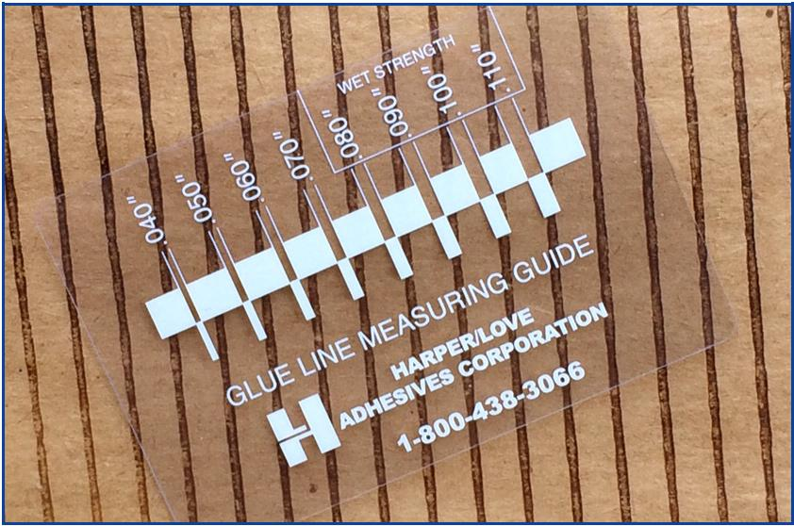
Guidelines on running Additive
Glue lines width
With increased glue line width adhesive shoulders are also increased which provides a barrier for the flute tip against water penetration.
contd---next slide
Amylodex Pvt.Ltd / Dorr Chemicals 03 Sep 2015 at WICMA Goa Bhaskar BV Reddy

Slide 10
Guidelines on running Additive
Run high solids ( 27-29 %) formulations
Run moist glue line
Keep minimum wrap /bridge content.
Paper Liner temperature are best around 82 degrees Centigrade
Run highest possible speed.
Full opening of steam shower on medium
Allow board to sit in stack for 4-8 hours. Longer is better as long as stacks are warm and moist.Graph explains same
contd---next slide
Amylodex Pvt.Ltd / Dorr Chemicals 03 Sep 2015 at WICMA Goa Bhaskar BV Reddy

Slide 11
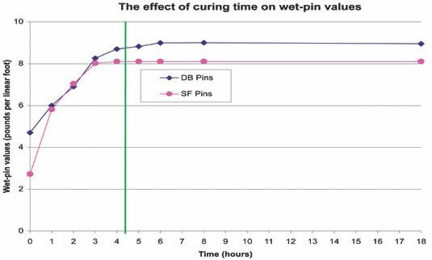
Guidelines on running Additive
Water Resistances / Stack time
Amylodex Pvt.Ltd / Dorr Chemicals 03 Sep 2015 at WICMA Goa Bhaskar BV Reddy

Slide 12

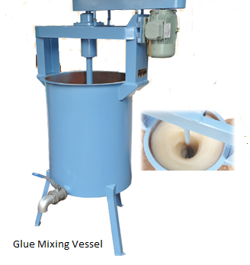
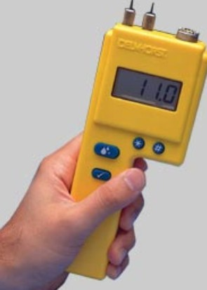
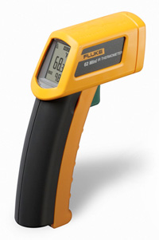
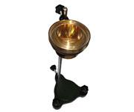
Amylodex Pvt.Ltd / Dorr Chemicals 03 Sep 2015 at WICMA Goa Bhaskar BV Reddy

Slide 13

Thank You
Amylodex Pvt.Ltd. (Formerly Stardex)
bhaskar@amylodex.com
Tele: 040 – 23060334 Fax: 040 - 23061638
Mob: 9866114029
www.amylodex.com
DOR Chemicals
Tel:972-4-9549650- Fax:972-4-9840508 -
Mobile:+972-52 6122549 or +44 77 000 40 826
E-mail : moris@dorchemicals.com
www.dor-group.com

